Slide 1
Global Water – Tortolita Water Company, Inc. Update
Jon Corwin, Vice President and General Manager
Beth Huerta, Client Services Manager December 2, 2022

Slide 2
Agenda
Global Water
System Improvements
Customer Portal
Rate Case Update
Customer Assistance Program Review

Slide 3
About Global Water
Founded in 2003
Only Operate in Arizona
Employ Approximately 100 Arizonans – Engineers, Certified Operators, Compliance and Safety Professionals
Provide Water, Wastewater and Recycled Water Service to Over 56,000 Connections
Conservation Focus
Total Water Management
Saved over 10 billion gallons of water since 2004
Customer tools for conservation

Slide 4
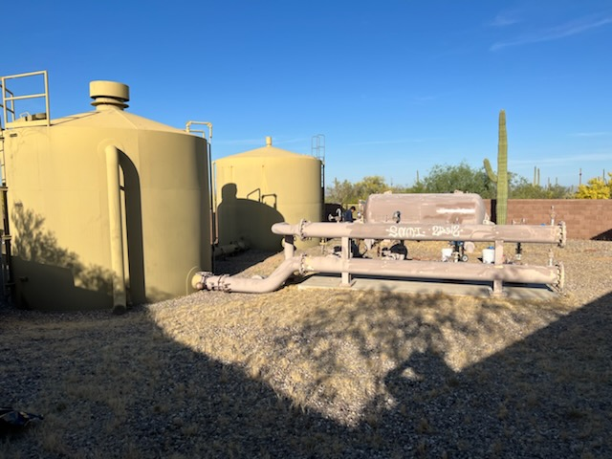
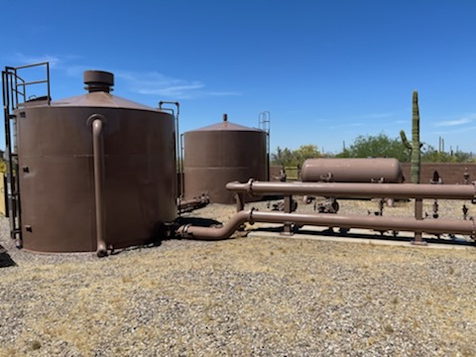
System Improvements
Registration of System as Public Water System
Previously no environmental regulatory oversight
System now has regulator oversight
Proactive Well Rehabilitation
Prevent potential prolonged outage
Replaced Booster Pumps
Replaced Air Compressor

Slide 5
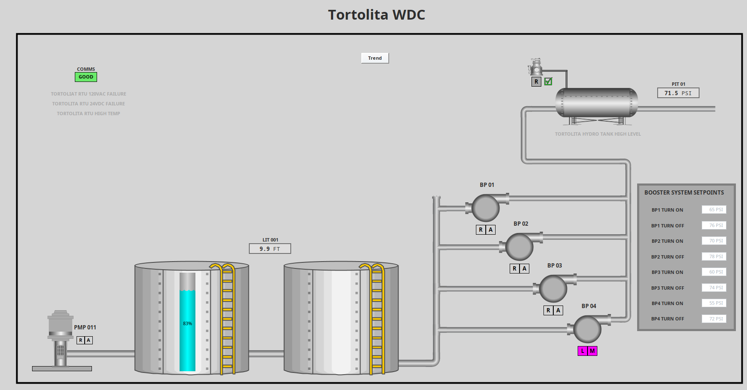
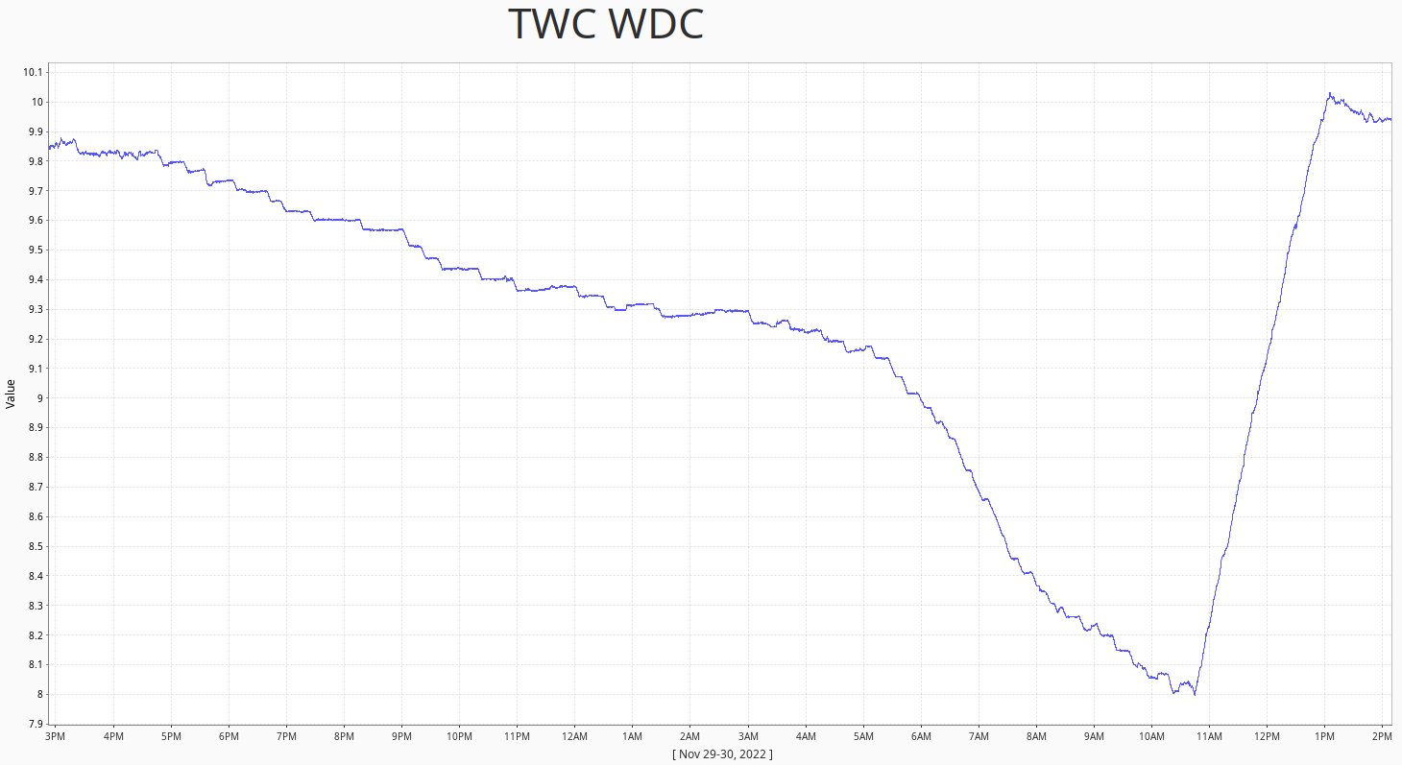
System Improvements
Added Remote Monitoring Capability
Increased system safety
Enhanced service
Added Water Disinfection
Launched Customer Portal

Slide 6
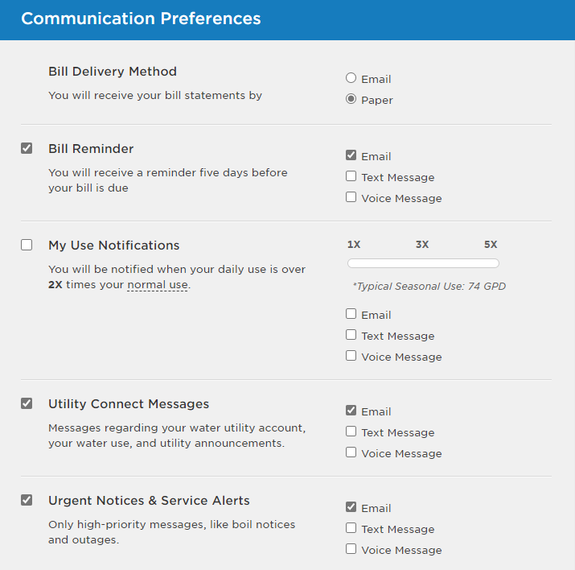
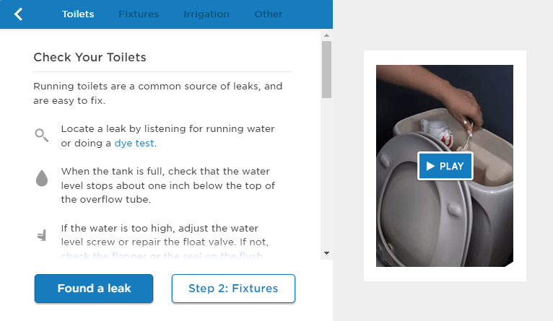
Customer Portal
Track Monthly Consumption
Set-up Usage Alerts & Billing Preferences
Easy Payment Methods
Tools to Troubleshoot High Consumption

Slide 7
Rate Case
Potential for Rate Case Filing in Mid-2023
In-depth review by Arizona Corporation Commission
No rate change until late 2023 or early 2024
Reason for a Rate Case
Inflation - Labor, Materials, Chemicals, Fuel, Power have all increased significantly
Last rate case was in 2004
Recover costs of system improvements
Process/Timing
Rate case timeclock is 270 days meaning, once we file, rates will not be implemented for 270 days
Commit to Come Back and Provide Updates

Slide 8
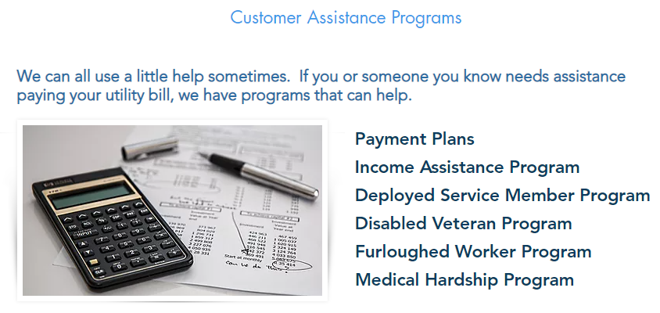
Customer Assistance Program
Customer Assistance Program
Up to $350 in annual assistance
Eligibility
Low Income
Deployed Service Members
Disabled Veterans
Furloughed Workers
Medical Hardship
$82,000 in Assistance in 2021

Slide 9
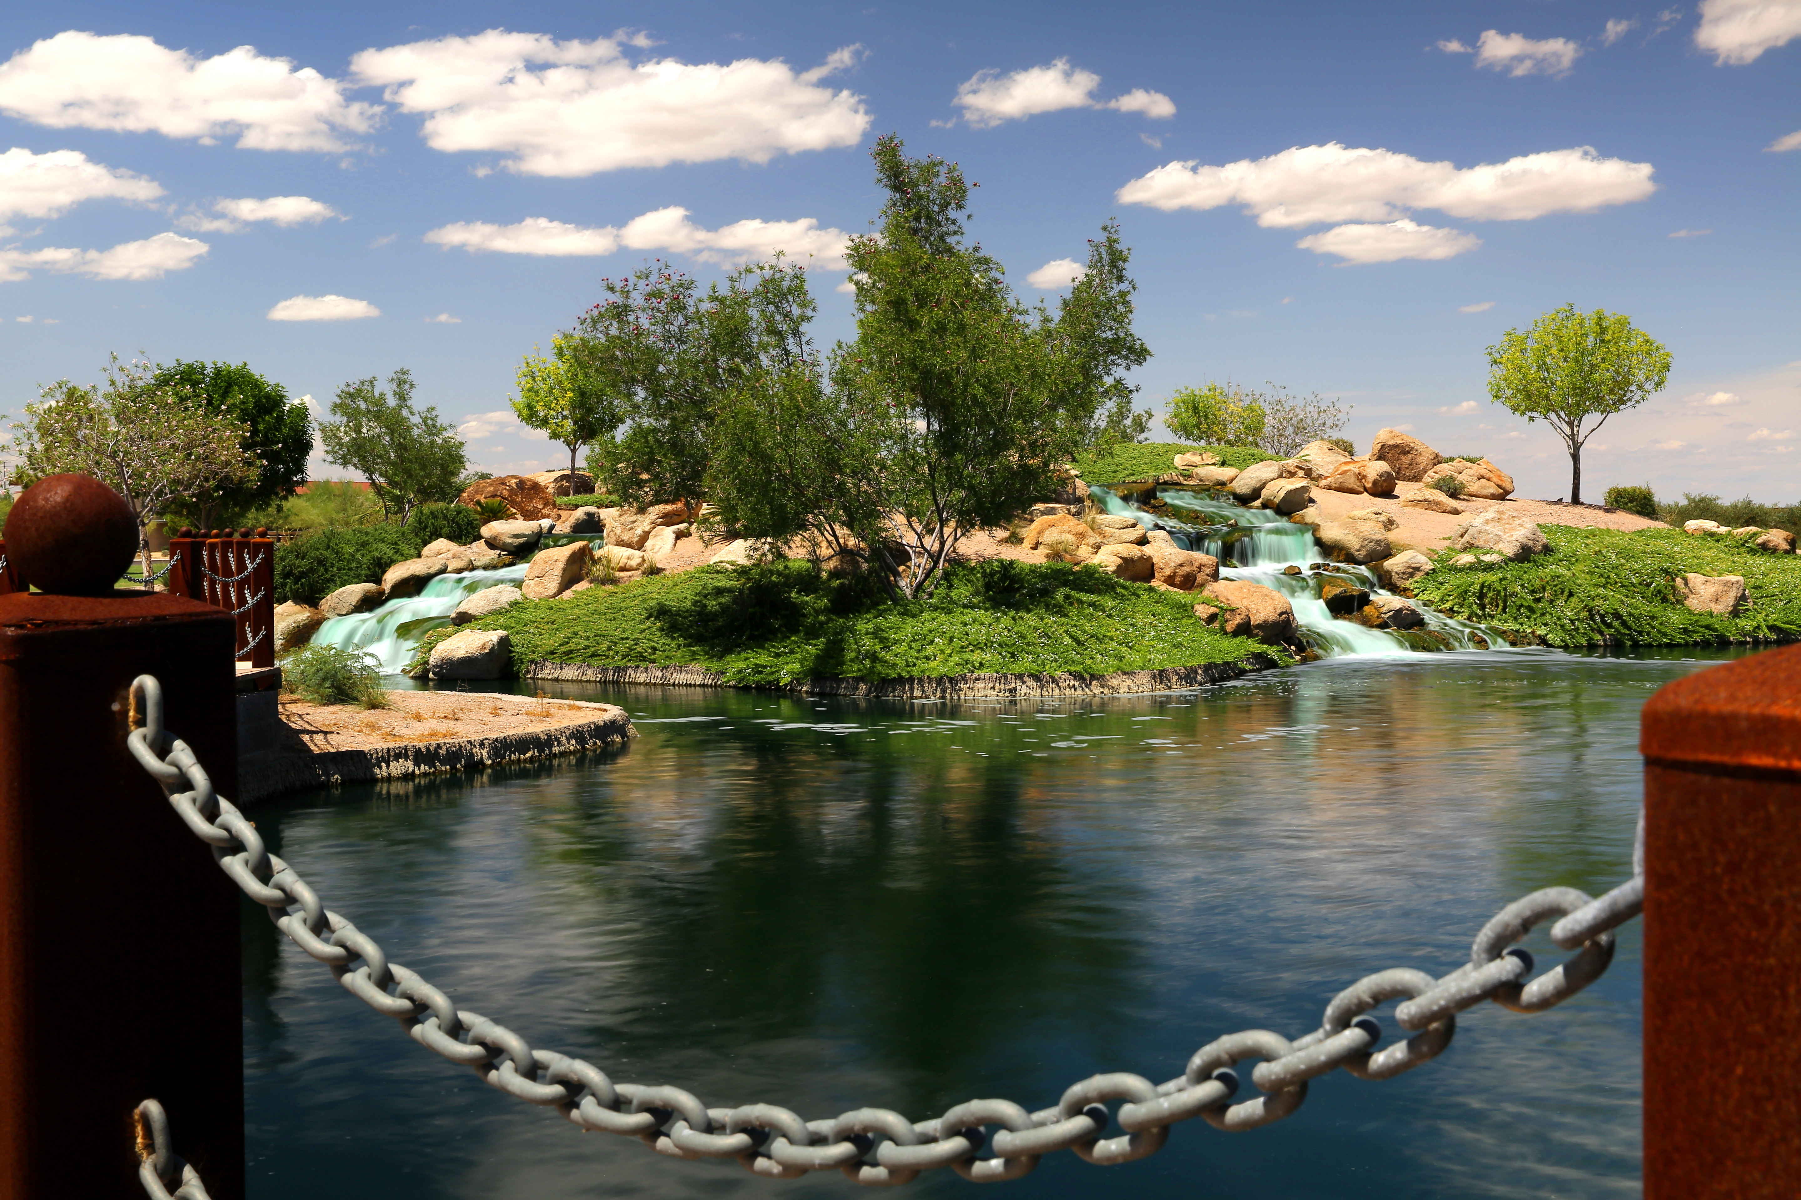
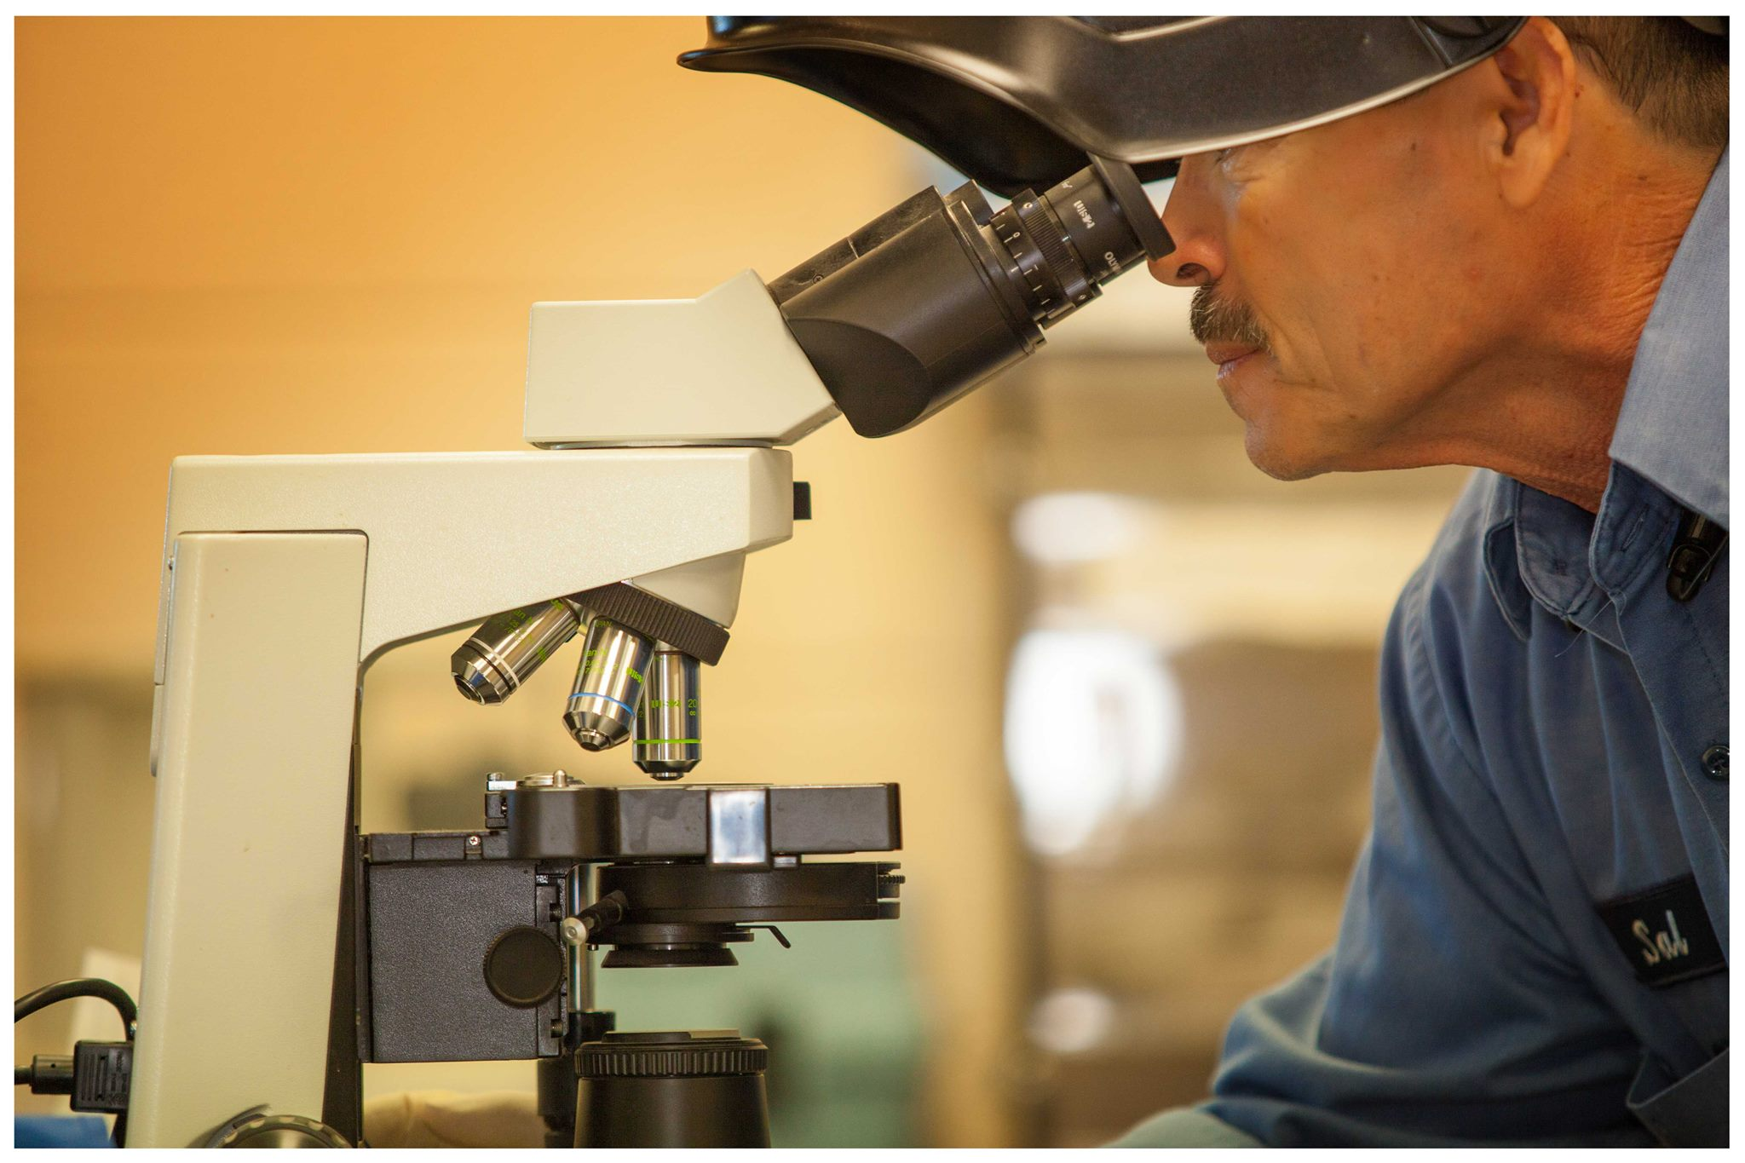
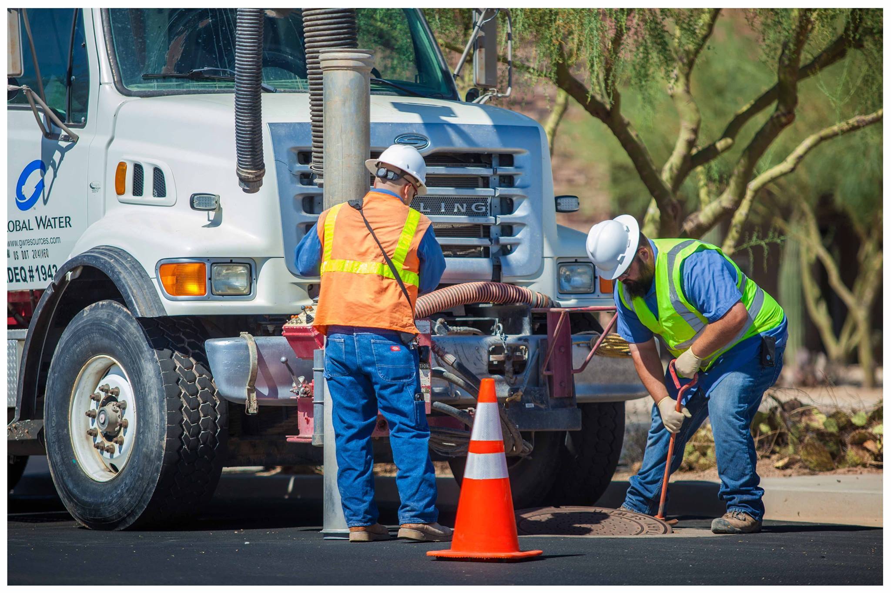
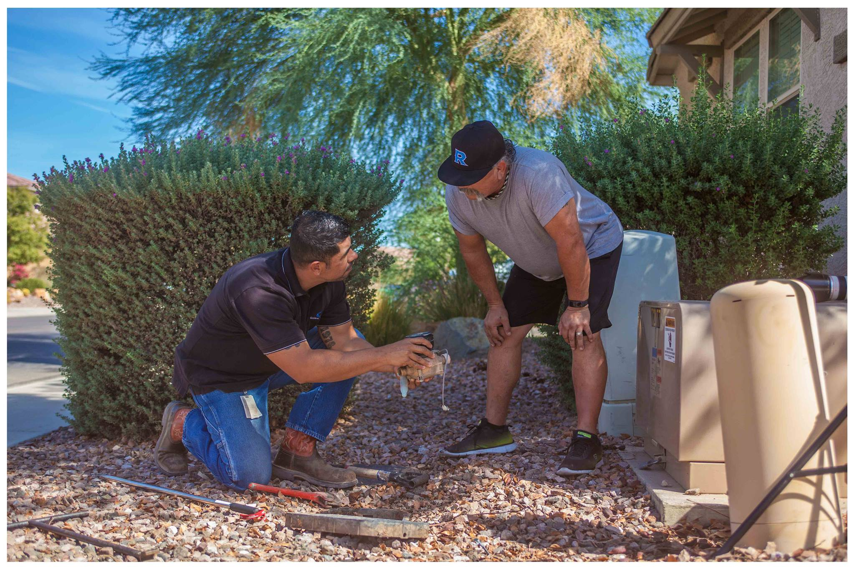
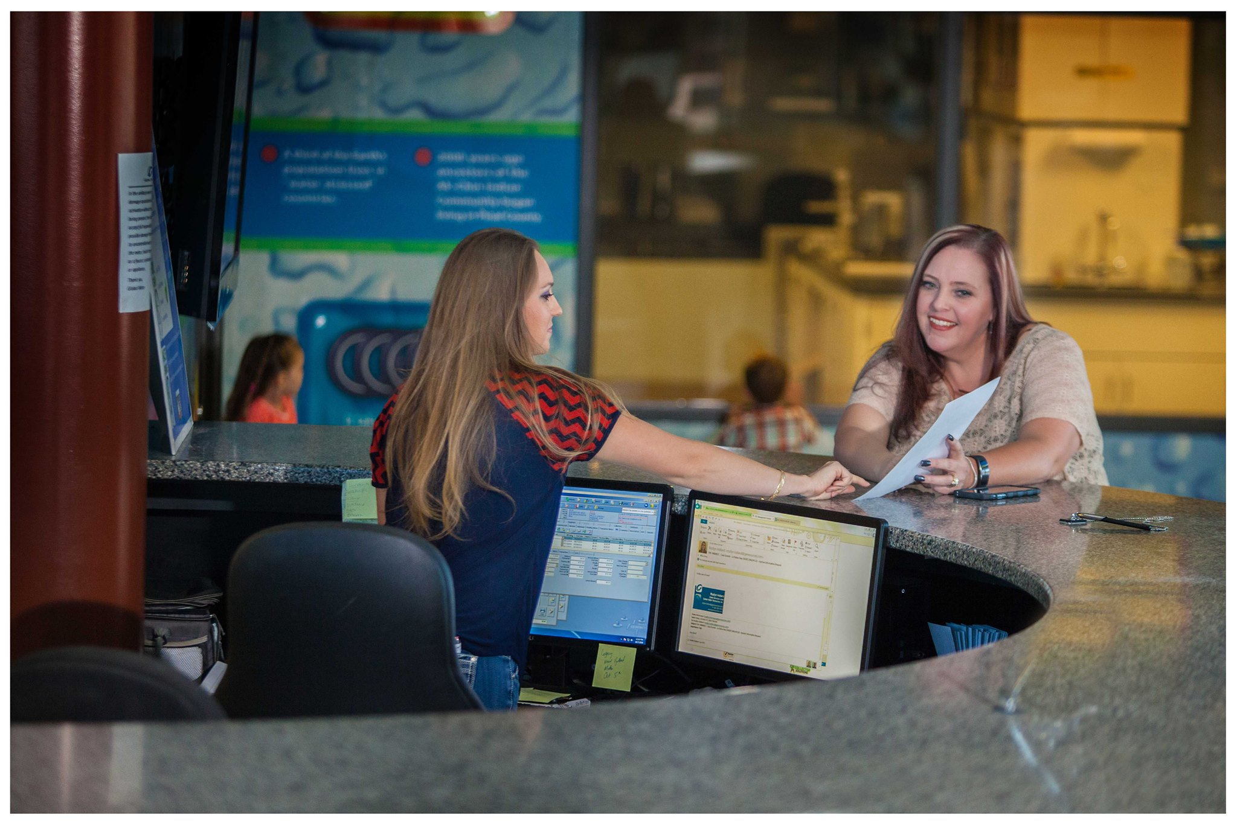
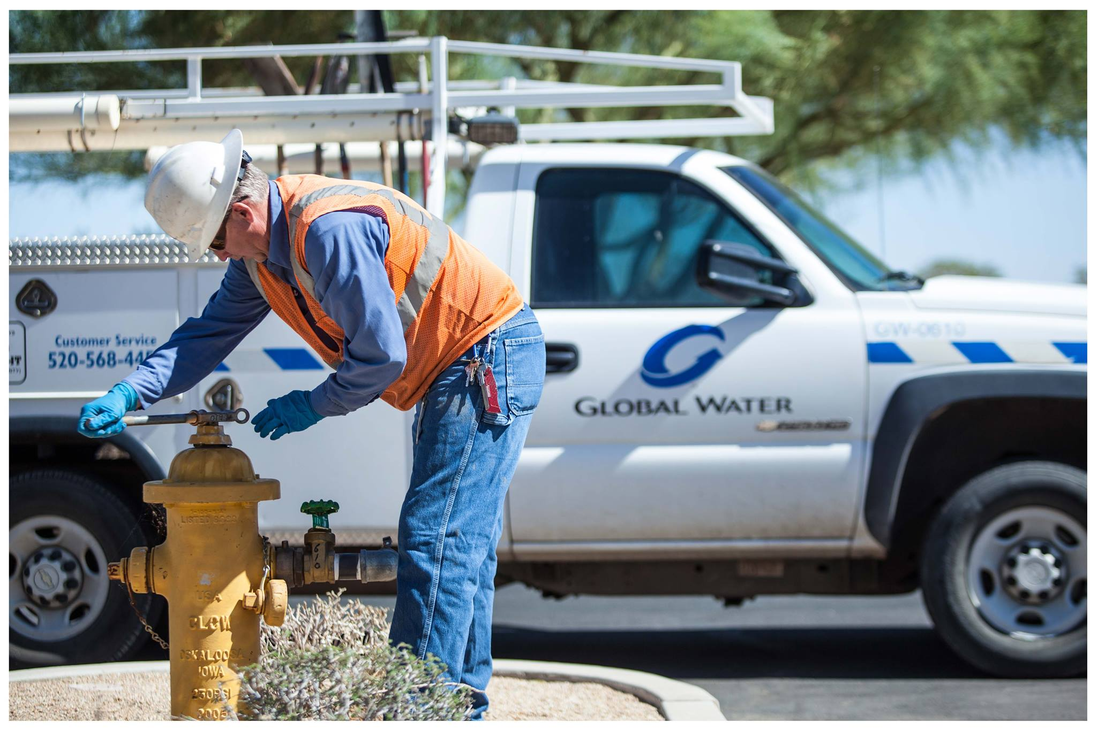
Thank You

